Slide 1
Flight Delays and Cancellations Project
Group 9: Hengyu Yang, Leyan Sun, Tianle Qiu, Yi Ma
Notes:
Good morning, everyone. Today, I’ll be sharing our project focused on understanding and predicting flight delays and cancellations during the holiday season—a time when disruptions can be especially challenging for travelers and airlines alike.

Slide 2
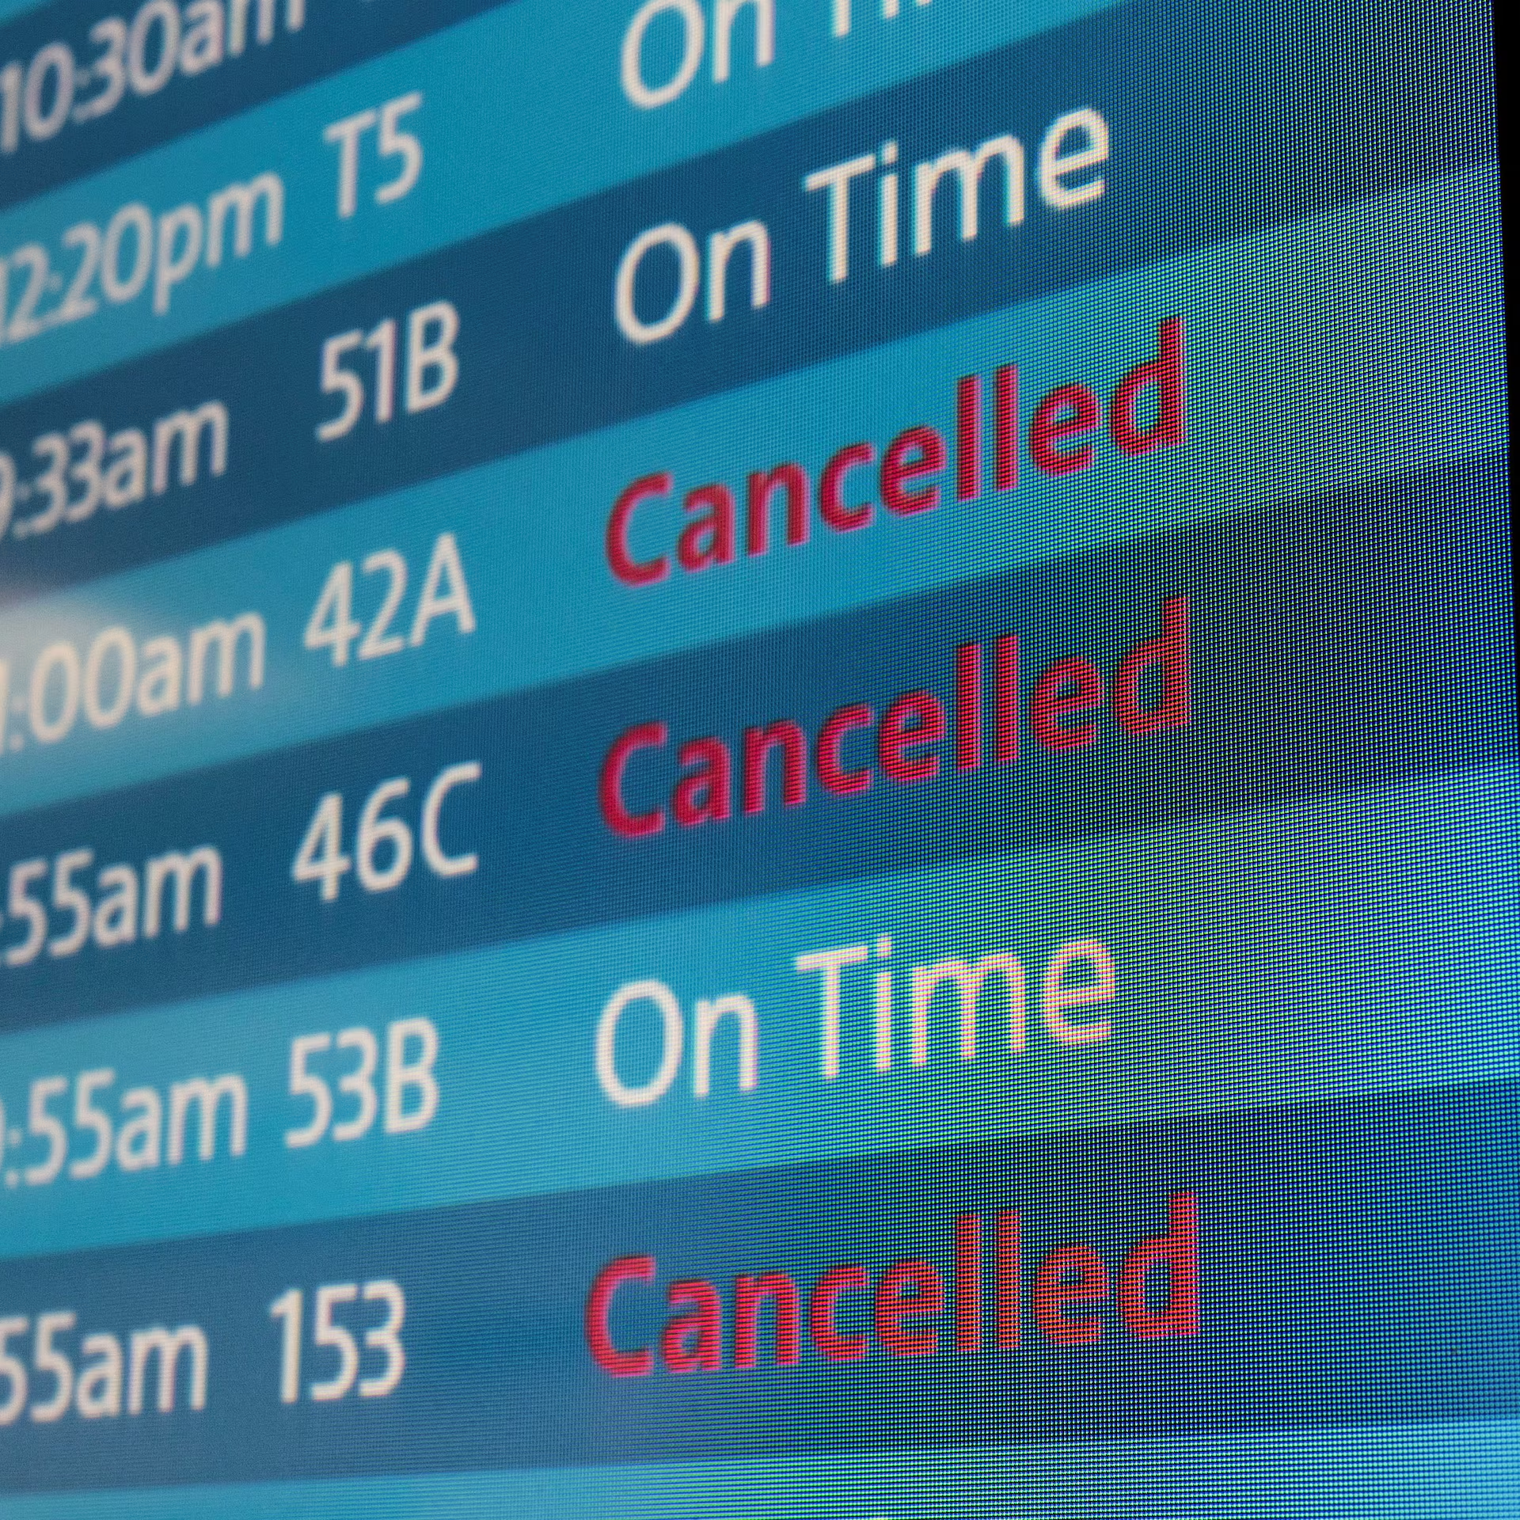
Introduction
Goal: Analyze factors influencing holiday season flight delays and cancellations to identify patterns and predict disruptions.
Outcome: Develop a logistic regression model to help passengers and airlines better manage holiday travel by predicting flight delays and cancellations.
Notes:
Our goal was to identify the key factors influencing these delays and cancellations, allowing us to anticipate patterns and potentially reduce their impact. The outcome of our work is a logistic regression model designed to help manage holiday travel by predicting flight disruptions.

Slide 3
Data Cleaning and Pre-process
Data Cleaning & Preprocessing: Streamlined dataset by removing redundant columns and filling in missing details, ensuring consistency across records.
Time Zone Standardization: Converted all times to UTC to maintain chronological accuracy across varying time zones, crucial for analyzing delay patterns.
Weather Data Integration: Matched weather records with flights using IATA and ICAO codes for complete weather coverage.
Outcome: A high-quality, temporally aligned dataset ready for analyzing flight delay patterns and providing insights for better holiday travel planning.
Notes:
To achieve this, we began with extensive data cleaning and preprocessing. This included standardizing time zones to UTC, ensuring chronological accuracy, and integrating comprehensive weather data. By matching weather records with flights using IATA and ICAO codes, we created a high-quality, temporally aligned dataset, ready for meaningful analysis.

Slide 4
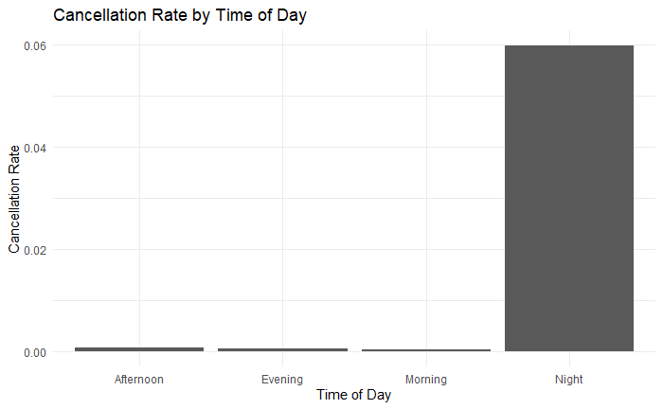
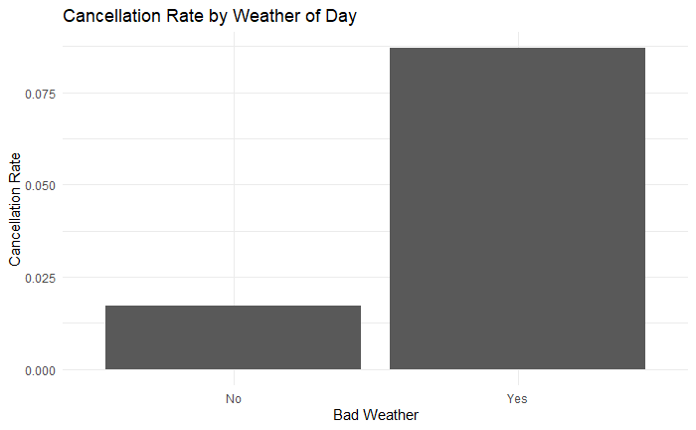
Exploratory Data Analysis
Weather Impact: Weather-related cancellations are 4x higher, highlighting weather’s major role in disruptions.
Airport Size: Larger airports face more delays and cancellations due to higher traffic.
Time-of-Day Effect: Night flights see higher cancellation rates due to fewer recovery options.
Notes:
In our exploratory data analysis, we observed some notable trends. Cancellations due to weather are four times more frequent, underscoring weather’s critical impact on flight schedules. Additionally, larger airports experience more delays and cancellations, likely due to increased traffic. Finally, flights scheduled at night show a higher cancellation rate, likely due to fewer options for operational recovery.

Slide 5
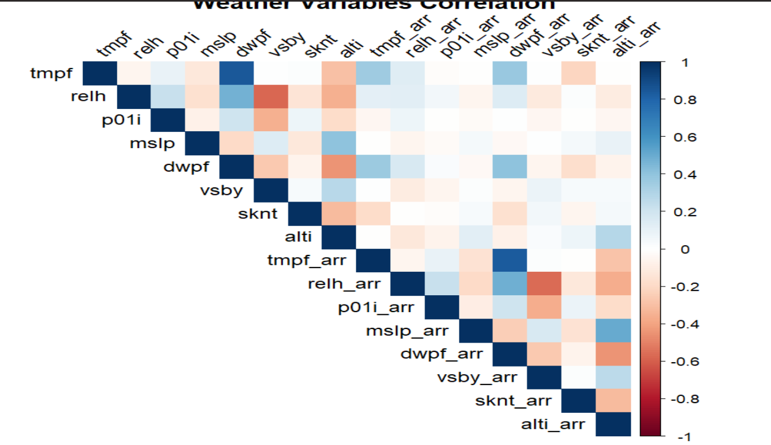
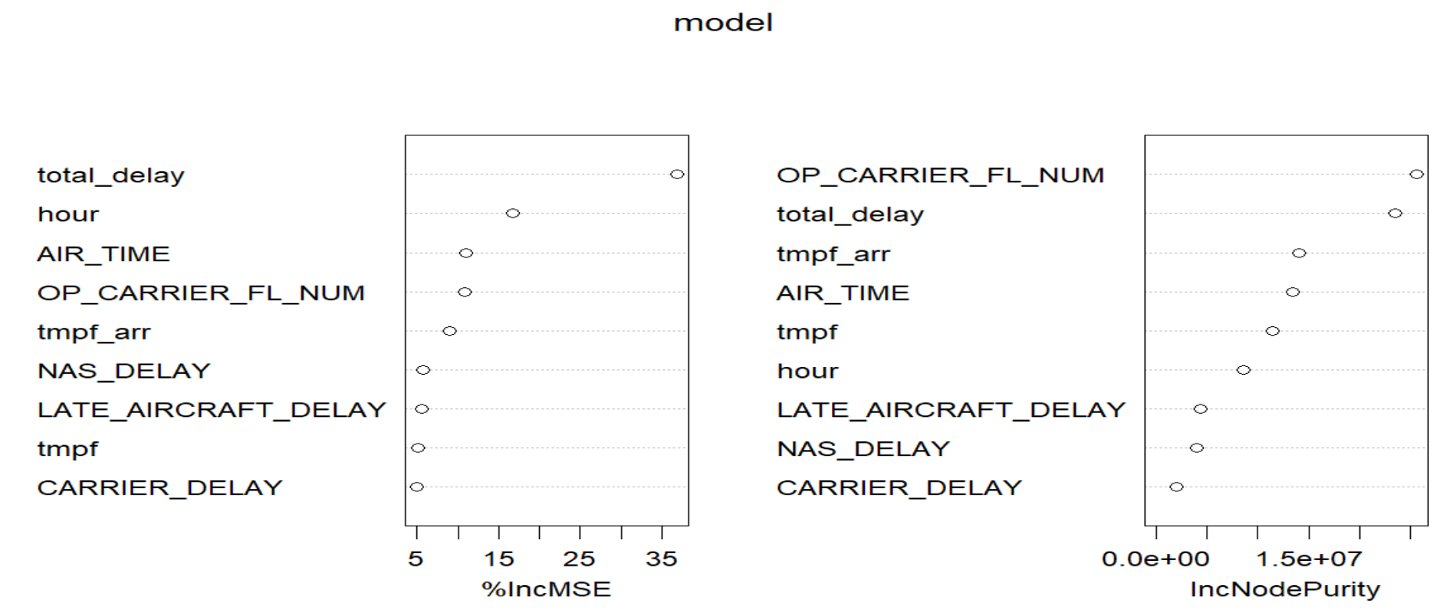
Feature Selection
Linear and logistic regression：OP_CARRIER_FL_NUM, OP_UNIQUE_CARRIER, tmpf, relh, sknt, vsby, CARRIER_DELAY, WEATHER_DELAY, NAS_DELAY, SECURITY_DELAY, LATE_AIRCRAFT_DELAY
Random forest: total_delay, LATE_AIRCRAFT_DELAY, NAS_DELAY, CARRIER_DELAY, OP_CARRIER_FL_NUM, AIR_TIME, tmpf, tmpf_arr, hour

Slide 6
Model Selection
3 Possible Model:
Linear Model: Poor behavior with a R^2 of 0.18 p-value = 2.2e-16
Random Forest: MSE：2192 RMSE：46.8
Logistic Model: With a balanced accuray 0.7

Slide 7
Discussion of Result
Predictive Model: Logistic regression model combines operational and weather-related factors to predict flight cancellations.
Key Operational Factors: Airline carrier, NAS delays, and security delays capture carrier-specific and system-wide disruptions.
Weather Variables: Temperature, humidity, wind speed, and visibility are critical predictors; extreme conditions raise cancellation risk.
Outcome: Model effectively anticipates cancellation probabilities, aiding travelers and airlines in managing disruption risks.

Slide 8
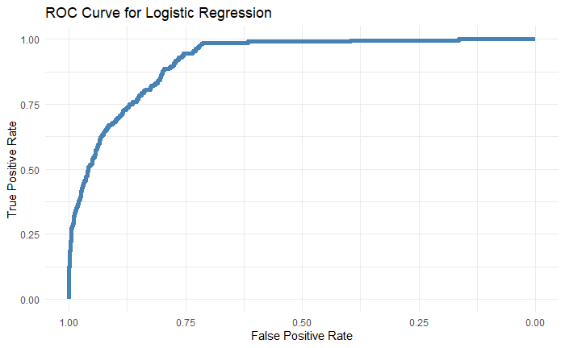
Discussion of Result
ROC Curve: Shows model's True Positive Rate vs. False Positive Rate.
Effectiveness: Curve near the top left indicates strong performance.
AUC: High AUC implies high accuracy in predicting cancellations.
Conclusion: Logistic regression effectively anticipates flight cancellations.

Slide 9
Strengths and Weaknesses
Strengths:
High accuracy in predicting flights that proceed.
Balanced view by incorporating operational and weather factors.
Clear and interpretable for decision-making.
Weaknesses:
Moderate accuracy in detecting cancellations.
May miss complex interactions; advanced models could improve results.

Slide 10
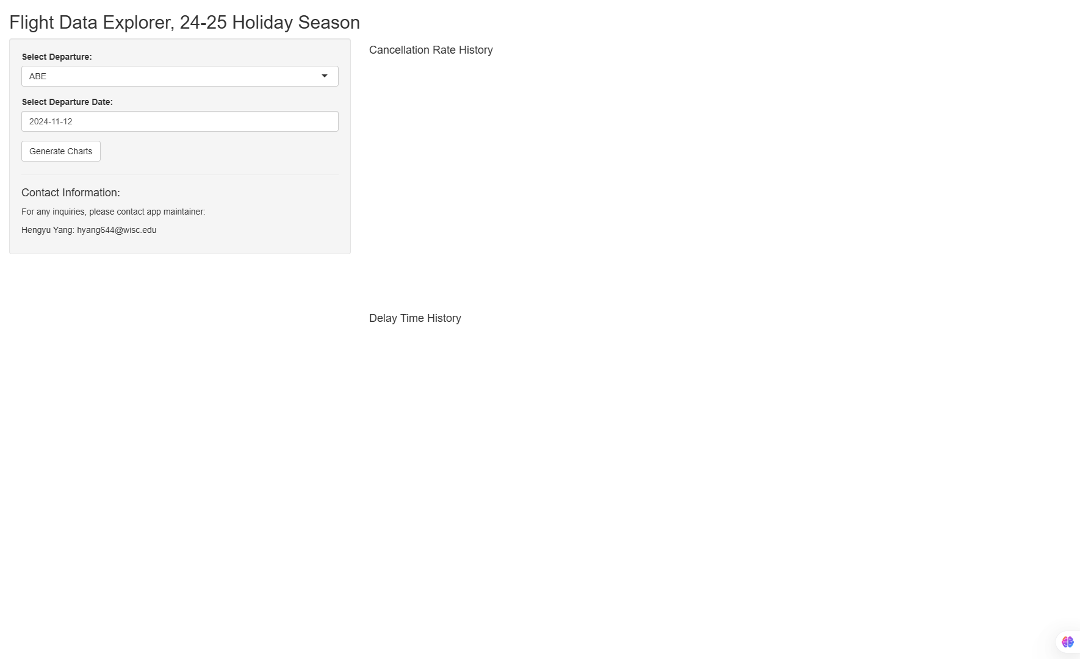
Shiny App
https://hyang644.shinyapps.io/flight_app/

Slide 11
Thanks!

